Slide 1
Medical information retrieval system
Presenters:-
Mohit Singh(MT23127)
Dheeraj Pandey(MT23034)
Tanmay Parashar(MT23100)
Shubham Kumar Choudhary(MT23093)
Shreeram Kumar Singh (MT23091)
Nitesh Kumar Chaurasia (MT23053)

Slide 2
Problem Statement
Develop a user friendly system for disease diagnosis and symptom analysis
Provide the users a list of potential diseases based on their symptoms
Comprehensive disease details along with treatment or diagnosis methods

Slide 3
Motivation
Despite the availability of vast health-related information on the internet, accessing relevant and accurate insights remains challenging.
Early detection of disease plays an important role in the treatment
Reluctance of some users to seek medical help for minor symptoms

Slide 4
Challenges and current state of art
Challenges
Difficulty in interpreting unstructured symptoms.
Lack of comprehensive prediction systems for universal disease detection.
Current State of Art
WebMD’s Symptoms Checker
Mayoclinic Symptoms Checker

Slide 5
Limitations of Current State of Art
WebMD’s Symptom Checker is an interactive application where the users have to select from a list of predefined symptoms. These symptoms are already fed to the data and thus require proper terminology when inputting the symptom and some users aren’t that much perfect in terminology which may result to wrong or no results.
Mayo clinic symptoms checker utilizes the information from Mayo clinic and takes input from a possible set of predefined symptoms, and related factors to predict possible causes.

Slide 6
Literature Survey
WebIRS: Enhancing Medical Information RetrievaL:
•Proposed System used document classification and text summarization techniques to deliver highly relevant medical information to physicians
•Naïve Bayes Classifier was used to categorize articles in to different categories
Electronic Medical Record System (EMR System):
•Medical record retrieval system which used semantic query expansion techniques to retrieve patient records relevant to patients current symptoms
•Term co-occurrence analysis was used for learning of semantic relationship heuristics from the EMR database

Slide 7
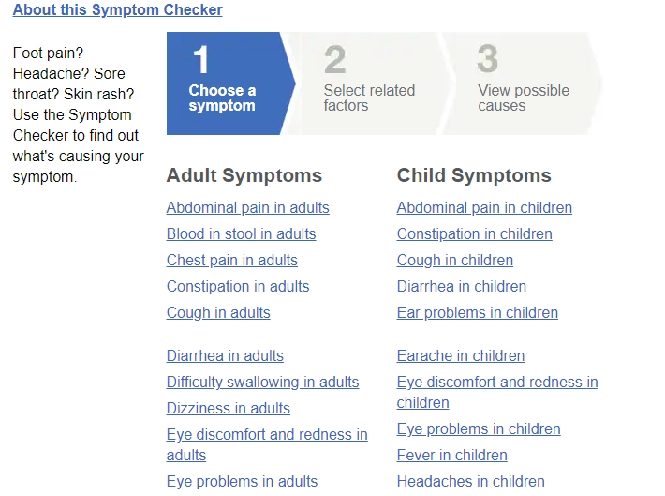
Novelty
Take symptoms as input compared to predefined symptoms in current SOTA (Mayoclinic Symptoms Checker)
Reference: https://www.mayoclinic.org/symptom-checker/select-symptom/itt-20009075

Slide 8
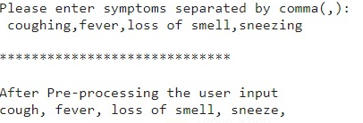
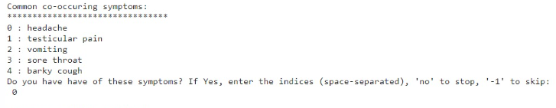
Novelty
Instead of predefined symptoms, we are asking user input for symptoms
Further, co-occuring symptoms are being suggested and taken as input to improve the accuracy of the prediction

Slide 9
Proposed Solution
Create a dataset of diseases and symptoms using wikipedia.
Suggest co-occurring symptoms based on the symptoms entered by the user for better understanding of potential health conditions and associated symptoms.
Integrate symptom suggestion
Implement Logistic Regression, Decision Trees, SVM, etc to predict the disease based on the input

Slide 10
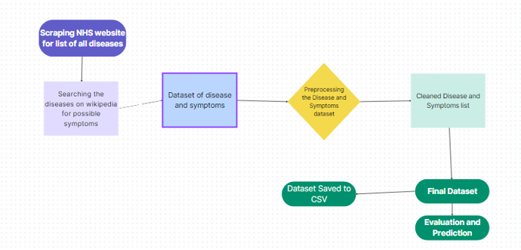
Proposed Solution

Slide 11
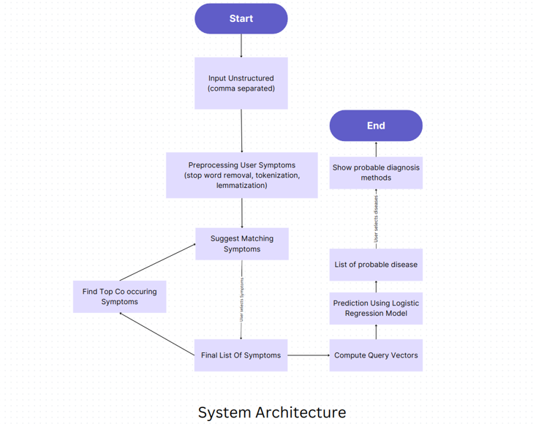
System Architecture

Slide 12
Progress of our system in future:
Short term goal (1-2 years) :
In 1-2 years, the system will focus on refining its disease prediction accuracy and efficiency. This includes algorithm enhancements based on user input and
synonym matching along with several integration of medical databases. Collaborations with healthcare providers will aim to pilot the system in clinical settings
for real-world effectiveness assessment.
Medium-term goal (3-5 years) :
In the medium term, The system plans to implement predictive analytics using machine learning and artificial intelligence using several databases along with the
user’s personalized dashboard where the past activity and his personal health data is stored. It will develop personalized disease risk assessment models based
on individual health data and genetic information.
Long term goal (6-10 years ) :
Efforts will focus on integrating the system into telemedicine platforms for enhanced health care accessibility as well as in the long term, the system aims to
integrate predictive modeling inwearable sensors for personalized health management. It will enable proactive disease management through early interventions
and tailored treatments. Collaboration with healthcare providers will drive advancements in precision medicine and population health management.

Slide 13
Thank You !!!

